Slide 1
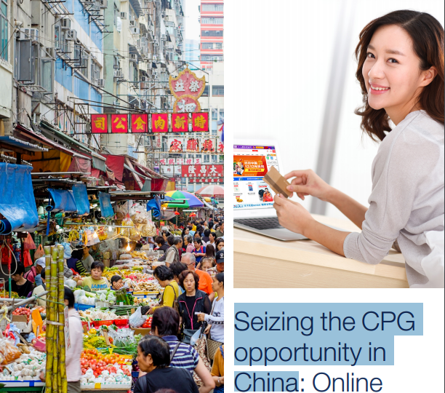
Seizing the CPG opportunity in China :
By
Amrit Venkat Vaibhav Muskan

Slide 2

Why are you looking at the China Market ?
(your business reasons)
Do you understand what your USPs are?
Have you evidence to show that a market exists in China for your Goods/service ?( market research)
How do you propose to sell in China?
Do you understand the geographic size of the market and know where to start.
Who are the customers you wish to target (consumers, local companies, Foreign companies in China , or official bodies)
Do you know how to carry out due diligence on customers/suppliers/partners.

Slide 3
Agenda
Market trends
Winning strategy
PSW
ISSUE Tree
Identify Top Category Product
solution
References

Slide 4
Insights based on market research
Life is digital-nearly three quarters are online daily
500 million out of poverty in 20 years ,thus high spending power
Difficult to drive loyalty-two third are willing to try new brands
Market Trends
Mobile-commerce is increasingly popular,as is mobile payment
A ‘me’ culture is prevailing
Pragmatism still rules
Majority of consumers are e-shoppers
Aggressive store expansion is replaced by improving store productivity

Slide 5
Child care
Top Category Product ?
Pet
Nutrition
Skin care
Small
Appliances
Hair care

Slide 6
Trends
To identify the top category Product
Hair Care
slower value growth in 2015 than in the previous year
Skin Care
Child Care
Pet Nutrition
high growth, due to the comparatively huge number of newborns and rising disposable incomes
Small Appliances
High growth within Pet food in 2015,
Reason –
performance of new products within premium Pet food that were in line with the health and wellness trend.
Growth of 5% in 2015, due to the high growth of new Western small appliances
willing to spend money on facial care at an earlier age, compared to the old generations, who may have higher disposable incomes.
mainly used by the
young consumers
Smart rice cookers are increasingly favoured
standard shampoos enjoyed very high product penetration in the country
Change in the One-Child Policy by government and allowed to have two children.

Slide 7
Future Scope
Hair Care
4% volume CAGR over the forecast period
(hair care is a relatively mature category in beauty and personal care)
Skin Care
Child Care
Pet Nutrition
The major driving factor –
the number of wealthy people is rapidly on the rise
premium brands of baby and child-specific products are expected to widen their presence
(manufacturers are planning to enrich their product portfolios)
Small Appliances
Pet products is expected to record a slightly higher performance
The major driving
factor –
Consumers prefer to purchase high-end products offering premium quality and manufacturers will raise quality and technological advancements
The major driving factor –
consumers’ trading up to high-end products, such as premium conditioners
The major driving factor –
the rising demand for better and healthier personal image
9% volume CAGR over the forecast period
4% volume CAGR over the forecast period
The major driving factor –
increasing pet populations

Slide 8
Competitor’s strategy
Hair Care
P&G continued to lead , with a value share of 40%
Skin Care
Child Care
Pet Nutrition
Strategy –
acquisition of Elsker, Johnson & Johnson , “Originated from nature, Love with Elsker”
Johnson & Johnson took the lead
Small Appliances
Guangdong Boyu Group took the lead, holding a value share of 2%.
Outcome –
managed to penetrate less-tapped rural areas
Strategy –
The rapidly-growing online sales channel, thanks to its rich product portfolio
Strategy –
new launches, profound nationwide distribution network and successful marketing
L’Oreal took comfortable lead , holding a value share of 12%.
Strategy –
establishing a strong channel network and strategic cooperation(regional large electronics and appliances retailers)
Outcome –
Enhanced the brand’s image
Strategy –
flexible sales strategy
Outcome –
well known and considered reliable by consumers
Outcome –
Enhanced its brand and product awareness
Outcome –consumers have easy access to small cooking appliances

Slide 9
Winning Strategy
Critical Success Factors
Treat e-Commerce as a top priority and a source of explosive growth
Invest heavily in distributor management and closely manage in-store execution
Omni-channel approach
Preference for high quality goods
Product Development in Health and wellness concern products
M&A continues to be an attractive avenue fuelling growth
Social media is used as a tool for customer loyalty

Slide 10
Problem Statement Worksheet
.
How can a client XYZ, one of the largest and fastest growing consumer goods companies in the
world, can improve its market share by volume in China from 6% to 10 % in the span of 2 years
1. Background and context
4. Constraints
The growth in various sectors is uneven(aging)
Household incomes are continue to rise
Urbanisation is creating a new consumer market
2nd largest world economy
Digital is reshaping consumer experience
Economic Uncertainty/Volatility
High Mkt Saturation
Low switching Cost
Tax Regimes
Financial Budget
Competitor’s data is not readily available
2. Desired Outcome
5. Stakeholders
Improved market share from 6% to 10 % in the span of 2 years
Re-position the brand strategy
Improve the frequency of purchase
Introduce new customers to the brand
Marketing & Sales Team
Portfolio Managers
Finance team
Analytics Team
6. Resources
3. Scope
Insights based on research, Past sales, channel Inputs
Unbaised Customer feedback and profiling, Digital analytics
Sales,Marketing,Analytics and Consulting teams
In Scope : Analysis on specific market segments
Out of Scope : Changing consumer behaviour

Slide 11
Issue Tree
How can ABC company increase its Market Share By volume, from 6% to 10%
By Stopping Share of decline
Identify/Create new market segments
Improving Distribution
By Increasing share of preference/Sales
By Consumer Satisfaction and Feedback
Understanding quality issues
Increasing Promotion
A1
A2
Scope
Out of Scope / Constraint
Terminal Node

Slide 12
Issue Tree
Identify/Create new market segments
Mergers/Acquisition
Analysis of Opportunity
BY Replicating regional players success on large scale
Market segments by Geography
Market segments by Demographics
Launching a new product
A1.1
Scope
Out of Scope / Constraint
Terminal Node

Slide 13
Issue Tree
Use
Leverage
Invest in
By Increasing Share of distribution
Increase Intensity of Each Channel
Add new Distribution Channels
Improving Logistics
Direct sales
Partnering With Ecommerce
Build more Retail Partnerships
Increasing sales force
Avoid multichannel Competition
A1.2
Once U saturate one channel only move to another
Direct Factory Shipping
Scope
Out of Scope / Constraint
Terminal Node

Slide 14
Issue Tree
By Increasing promotions
TV Advertisements
Digital Marketing
Print Media
Branding(conducting Branding analysis)
Ergonomics
Logos and Packing Design
Visual Aids(Use of effective communication)
Mobile / Web Apps
Online Advertisements
A1.3
Scope
Out of Scope / Constraint
Terminal Node

Slide 15
Issue Tree
By Stopping Share of decline
By Consumer Satisfaction
Understanding quality issues
Packaging Issues
Services/Warranty
USE TQM,SIX SIGMA
A2
Get Unbiased Feedback
Scope
Out of Scope / Constraint
Terminal Node

Slide 16
References
http://businesscasestudies.co.uk
http://createsend.com/
Data from Euromonitor
www.tradingeconomies.com
www.mckinseyonmarketingandsales.com
www.fractalanalytics.com

Slide 17
China is bringing fundamental change to all our lives – be prepared!
Thank You !

